Slide 1




Welcome
Auckland UC
Users Group
July 30th 2015
Our Sponsors:
Notes:
Our 3rd Meetup.
We have a blog to view past meetups
Plan to have a meetup on a quarterly basis
Suggestions, more technical? More sales driven? User?
Please provide feedback

Slide 2







Introductions
Andrew Morpeth – Lexel Systems
Lync Technical Consultant, MVP
@AndrewMorpeth
http://www.lync.geek.nz/
Paul Bloem – Lexel Systems
UC Principle Consultant, MVP, VTSP
@PaulB_NZ
http://www.ucsorted.com/
Matthew Borchert – Jabra
Business Manager
https://www.linkedin.com/pub/matthew-borchert/10/b80/253
http://www.jabra.co.nz/

Slide 3
Agenda
Time | Topic
3-3:30pm | Skype for Business: Outlining the difference between On Premise, Online and Hybrid
3:30-4pm | Roadmap
4-4:30pm | Networking Break + Food and Drinks
4:30-4:50pm | All about Jabra - Matthew Borchert
4:50-5pm | Wrap up and prize draw (TBA)

Slide 4


What's in a name?
Skype for Business Server 2015
Skype for Business Online
Other Skype for Business OnLine options
Skype for Business Hybrid*
Notes:
Skype for Business Server 2015: This on-premises server provides IM, presence, peer-to-peer VoIP and video, conferencing, enterprise voice, and telephone-system (PSTN) connectivity.
Skype for Business Online: This service in Microsoft Cloud or Office 365 provides IM, presence, peer-to-peer VoIP and video, and conferencing. It does not provide enterprise voice or PSTN connectivity, but Microsoft says these features are in development.
Other OnLine options
Skype for Business Server 2015 + Skype for Business Online = Skype for Business Hybrid

Slide 5

Skype for Business Server 2015
Persistent Chat, CQM, Monitoring Reports
Enterprise Voice
  Forward, transfer, simring
  Response Groups (IVR)
  Dial Plans
  Toll Code Restrictions
Contact Centre
Call Recording
QoS
Notes:
Business Server 2015 (On Premise) includes all functionality.

Slide 6
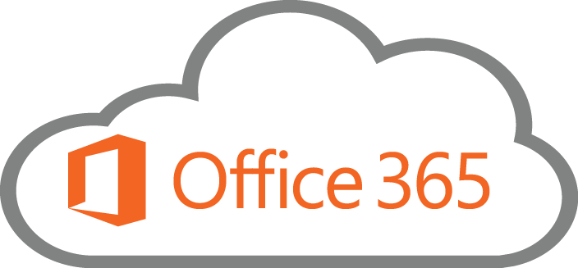

Skype for Business Online
Today
IM, Presence
Audio and Video
Web Conferencing
No Enterprise Voice*
No PABX features*
No Dial in Conferencing*
Notes:
Delivered via O365
NO EV
Not a PABX replacement option (yet)

Slide 7

Other Skype On Line options
Notes:
Per user per month
Contract?
Provides EV, RGS
Call recording and contact centre can be included
Reporting
Leveraging O365 licensing
Can be used in conjunction with O365 email
No on premise server requirements
No QoS

Slide 8

Skype for Business Hybrid
The best of both worlds
Use Case?
Notes:
Delivered via OnPrem and O365.
Special cases…

Slide 9

On Premise vs Cloud*
Functionally
Licensing
Infrastructure investment
Business Requirements
Notes:
What is Cloud?
Public Cloud
Private Cloud
Functionally needs to do whats required by the business. If you need PC then Online just wont do.
Rather simple right now..for now.
Licensing is not so much of an issue now that its possible to license in the cloud via 365 and use that on Premise.
Infrastructure Investment (and deployment) can be a limiting factor for smaller organizations. 3rd party Online services may suffice here..
BUT there is a break even point where financially on premise starts to become cheaper.
Then there is the support factor, HA, DR, Resillience and so on. Online will not guarantee any of these at this time.
What does the business need? A platinum plated PBX and VC solution with contact center? Or will a works most of the time with vanilla feature set do?

Slide 10

Cloudy with Thunderstorms
When Cloud wont do:-
  HA and DR
  Internet connectivity issues:-
    Access
    Speed
    QoS
Enterprise Voice
Monitoring and Compliance
???

Slide 11
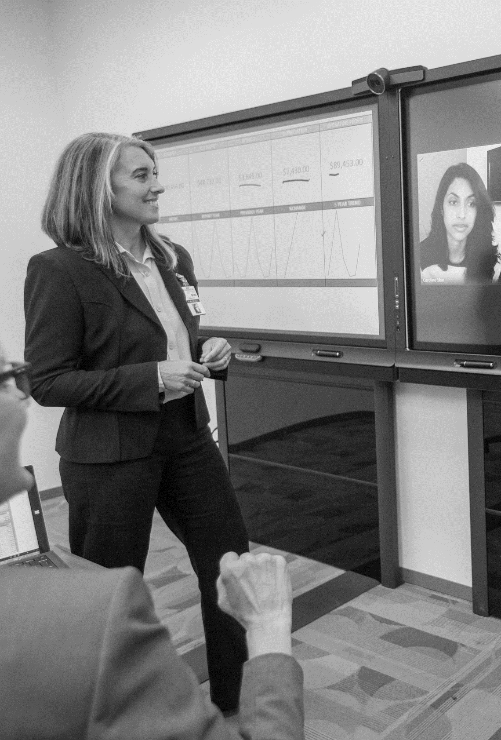
Skype for Business Online - Roadmap
Complete meeting solution including PSTN Conferencing
Call management with your
Cloud PBX
PSTN Calling offers plans with minutes directly from Microsoft
Notes:
Skype Meeting Broadcast: This feature allows as many as 10,000 people in a meeting broadcast, such as for webinars.
PSTN Conferencing: This feature lets people dial into a call from a landline or mobile phone if they don’t want (or cannot) join in through their PC, mobile device, or browser.
Cloud PBX with PSTN Calling: This feature lets people make traditional phone calls through their Skype for Business client without having a traditional on-premises PBX. You’re given blocks of numbers to choose from based on your region, and you can assign these numbers to your users. (Microsoft plans to eventually offer a configuration option where you can use existing on-premises phone lines.)

Slide 12
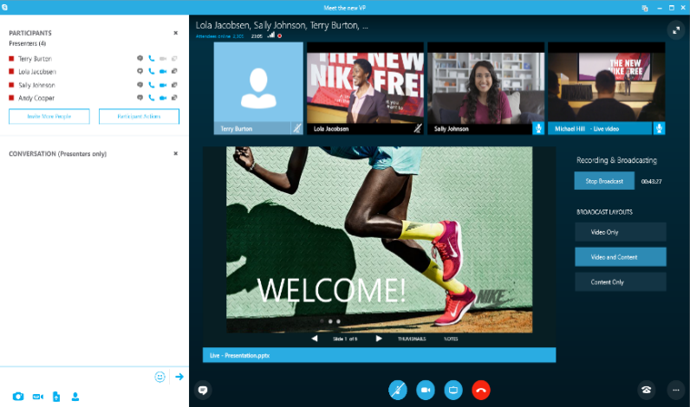
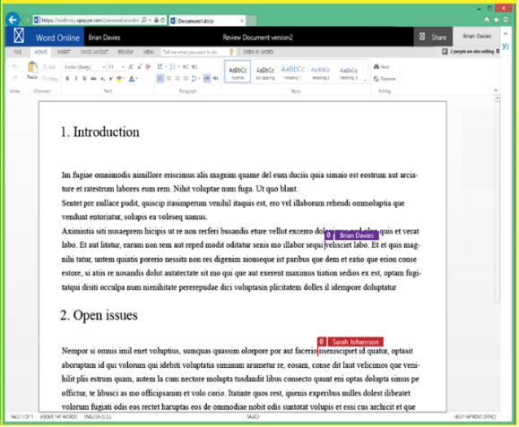
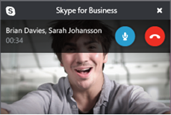
Complete meeting solution
New
Skype meeting
broadcast
Reach thousands for very large meetings, attendees join from virtually any browser and device
New
PSTN
conferencing
Use a dial-in number to join
Skype meetings from any device, dial-out to bring participants
into the meeting
Skype meeting broadcast
Connected meeting experience
Modern attachments, ‘meet now’ in unified groups,
online meetings by default
Video and content sharing
Office real-time co-authoring in Skype for Business,
fast HD video-based screen sharing
Surface hub and skype room systems
Team collaboration device from Microsoft, full spectrum
of meeting devices with partners
Office real-time
Co-authoring in skype for business
Notes:
Skype Meeting Broadcast
Organize and produce a new broadcast style meeting for up to 10,000 attendees
Join and watch via any modern browser, on any device
Rewind, pause and resume playback based on your own schedule without affecting the broadcast
Participate in a Bing Pulse and Yammer conversation about the event
PSTN Conferencing
Schedule meetings with dial-in coordinates automatically embedded within the meeting invite.
Join meetings of users hosted in Skype for Business Online via PSTN Conferencing.
Organizers and participants will be able to dial-out to others from within a meeting.
Organizers and participants will be able to join the audio portion of a meeting via the “Call me at” functionality.
Organizers and participants joining via PSTN conferencing will be announced to other phone users when they join and leave the meeting

Slide 13
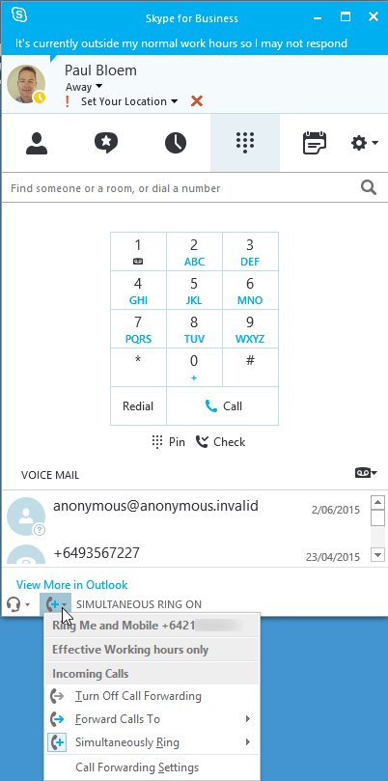
Cloud PBX and PSTN calling
New
Cloud PBX
Manage your calls right within O365; eliminate separate PBX systems
for information workers
  Everywhere access
  Make, receive and transfer calls from mobiles, tablets, and PC’s,
  from nearly anywhere with internet access
  Consolidated management
  Office 365 administration portal as the central location to
  manage users for communications, email and content
  Global deployment options
  Take advantage of your existing telephony infrastructure
  (i.e. traditional PBX systems or on-premises SIP trunks)
New
PSTN calling
  Subscribe to calling plans from Office 365, use existing phone
  numbers or get new ones, starting in the US this year
Notes:
Cloud PBX with PSTN Calling: This feature lets people make traditional phone calls through their Skype for Business client without having a traditional on-premises PBX. You’re given blocks of numbers to choose from based on your region, and you can assign these numbers to your users. (Microsoft plans to eventually offer a configuration option where you can use existing on-premises phone lines.)

Slide 14
Cloud PBX functionality roadmap
Make and answer call, hold, retrieve, and transfer
Mobile, PC, and browser clients
Call forward, simultaneous ring, delegation, team calling, voice mail, and auto attendant
Static E-911
IP Desk phones
Response groups, group call pickup, voice feature control, outgoing CLID, and unassigned numbers
Dynamic E-911
Common area phones

Slide 15

O365 – The Fine Print
Microsoft Recommend OnPrem to provide QoS and Resilience
New E5 O365 licence
ExpressRoute for ITSP’s
Direct Media?
Notes:
New E5 o365 licence category added, essentially adding Cloud PBX features into o365 Lync
o365 Skype will include Cloud PBX features under the new E5 licence but:
USA only will get PSTN breakout for 2016
AND even then they recommend on prem Skype4B servers for Telco break out to provide QoS and Resilience
NO timeline mentioned anymore for global rollout
They reiterated that Lync is about driving meetings, and is not a feature for feature race against legacy VoIP players.

Slide 16
Q and A

Slide 17
Thank You!
Auckland UC
Users Group
July 30th 2015
Our Sponsors:

